Slide 1
Rotavirus
By Mamita Rai Gurung

Slide 2
General features
The rotaviruses belong to the family Reoviridae.
They are naked, icosahedral shaped, spherical particles 65 to75 nm in diameter
Contains 11 segments of double-stranded RNA and a double-shelled outer capsid
It is resistant to stomach acid so it can reach small intestine.
Have 6 serotypes. Three serogroups have been associated with disease in humans (groups A, B, and C).
The name is derived from the Latin rota(“wheel”) because of the outer capsid which resembles a wheel attached by short spokes to the inner capsid and core

Slide 3
Contd......
Causes disease
Gastroenteritis in young children especially. While adult and older people can also get infected.
Is characterized by nausea, vomiting and watery non-bloody diarrhea can lead to dehydration and electrolyte loss in children.

Slide 4
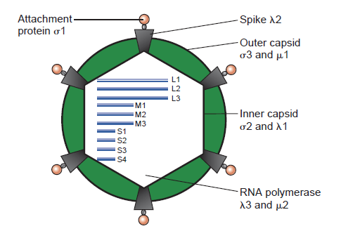

Slide 5
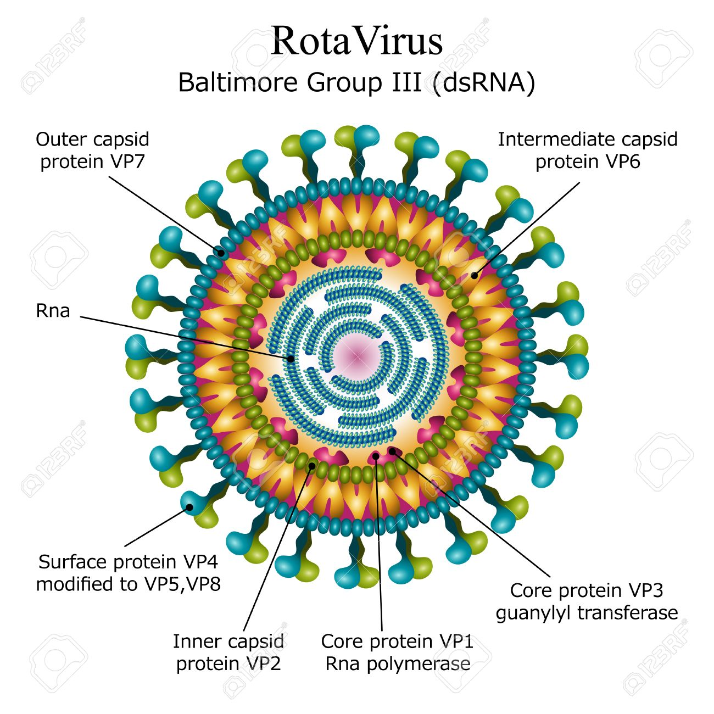

Slide 6
Virulence factor
While the specific gene product associated with virulence is not yet known, some evidence suggests that one nonstructural protein (NSP4), may behave as an enterotoxin similar to the heat-labile enterotoxin (LT) of Escherichia coli and cholera toxin.

Slide 7
Epidemology
Rotavirus infection is most common cause of diarrhea among infants and children 1 to 24 months of age. Older children and adults can also be affected, but attack rates are usually much lower.
Morbidity is highest in young people
Outbreaks of rotavirus infection are common, particularly during the cooler month
Transmission Faecal-oral route.

Slide 8
Pathogenesis
Incubation period 1 – 3days.
It replicates in mucosal cells of small intestines and damages the transport mechanism.
Rotaviruses appear to localize primarily in the duodenum and proximal jejunum, causing destruction of villous epithelial cells with blunting (shortening) of villi and infiltrates of mononuclear and a few polymorphonuclear inflammatory cells within the villi.
The gastric and colonic mucosa are unaffected; No inflammation.
The primary pathophysiologic effects are a decrease in absorptive surface in the small intestine and decreased production of brush border enzymes, such as the disaccharidases.
Results in transient malabsorptive state, which may further results in excess fluid and electrolyte secretion.
Viral excretion usually lasts 2 to 12 days but can be greatly prolonged in malnourished or immunodeficient patients.
Infection is restricted to GI tract only.

Slide 9
Lab diagnosis
Sample :-stool
Detection of virus particles in the stools during the acute phase of illness by electron microscopy
Immunological Test
detection of antigen with EIA(Enzyme Immuno Assay)
ELISA
PCR(Polymerase chain Reaction)

Slide 10
Treatment
There is no specific treatment. Vigorous replacement of fluids and electrolytes is required in severe cases and can be life-saving.

Slide 11
Prevention
The rotaviruses are highly infectious and can spread quickly hence roper hygiene is important.
A vaccine containing live attenuated virus was available but was withdrawn due to side effects.
Breast milk can protect newborns up to 6 months of age.

